Slide 1
Lab 6
ITEC618
Preparation for Assessment 3
Dr. Farshid Keivanian

Slide 2
Part 1: Warm-up OOP Concepts Report (10%)
1. Instructions:
Write a 500+ word report explaining four OOP concepts (e.g., inheritance, polymorphism, encapsulation, abstraction) covered in lectures 8-11.
Provide examples in your own words or as code snippets.
Reflect on real-world applications of OOP concepts and their potential impact on society.
2

Slide 3
Part 1: Warm-up OOP Concepts Report (10%)
2. What you need to do:
Select four OOP concepts.
Illustrate each concept with a relevant example (can be written code, diagram, or explanation).
Conduct research and reflect on how these concepts are applied in real-world software development, focusing on the broader impact of OOP on the common good.
3

Slide 4
Part 1: Warm-up OOP Concepts Report (10%)
package example;
public class Example {
public static void main(String[] args) {
// Create an instance of Animal and Dog
Animal genericAnimal = new Animal();
Dog dog = new Dog();
// Call makeSound method on both objects
genericAnimal.makeSound(); // Outputs: Animal sound
dog.makeSound(); // Outputs: Bark
}
}
class Animal {
String name;
int age;
public void makeSound() {
System.out.println("Animal sound");
}
}
class Dog extends Animal {
@Override
public void makeSound() {
System.out.println("Bark");
}
}
3. Similar Example
Example of Inheritance:
4

Slide 5
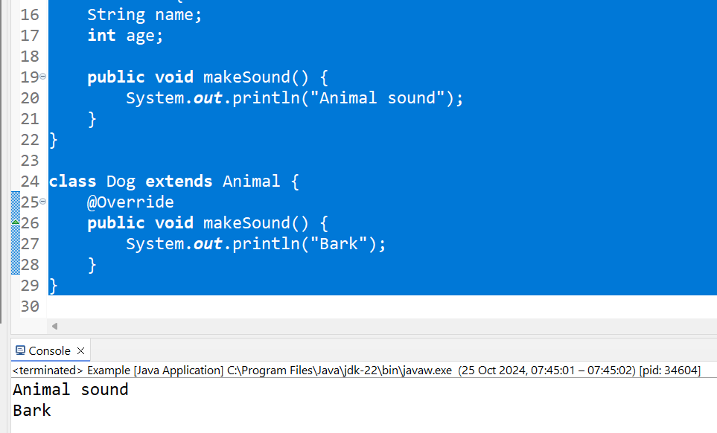
The result shows that the makeSound method in the Animal class is called for the genericAnimal object, outputting "Animal sound," while the overridden makeSound method in the Dog class is called for the dog object, outputting "Bark."
5

Slide 6
Part 2: OOP Case Study Implementation (30%)
Task 1: Superclass Product Creation (3%)
Instructions:
Create a superclass Product to store information such as product ID, name, type, and price.
Include a toString() method to display the product information.
6

Slide 7
Part 2: OOP Case Study Implementation (30%)
2. What you need to do:
Define the Product class with relevant attributes.
Implement a constructor and accessor methods (getters and setters).
Write a toString() method for formatted output.
7

Slide 8
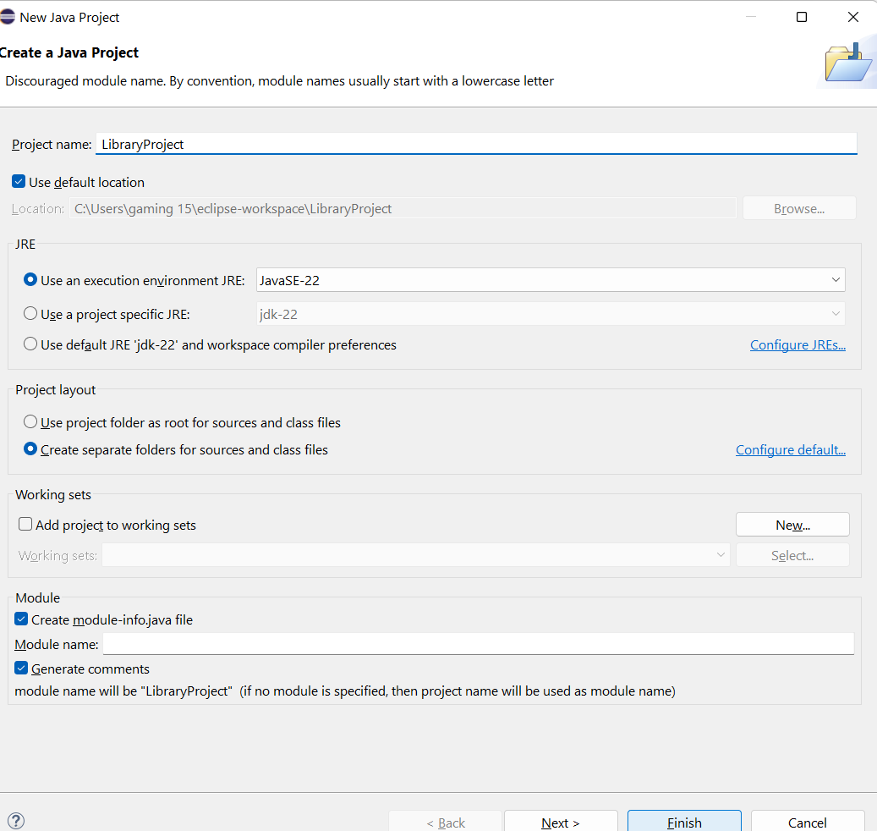
Part 2: OOP Case Study Implementation (30%)
3. Similar Example:
Superclass for a Library Book:
Step 1: Open Eclipse
Launch Eclipse IDE on your computer.
Step 2: Create a New Java Project
In the File menu, select New -> Java Project.
Enter the project name, e.g., LibraryProject.
Click Finish.
8

Slide 9
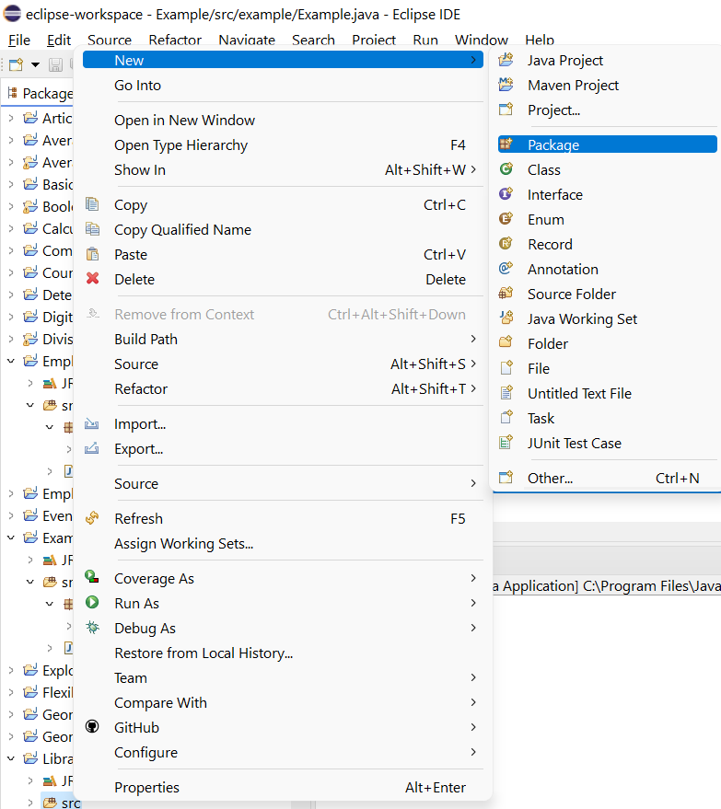
Part 2: OOP Case Study Implementation (30%)
3. Similar Example:
Superclass for a Library Book:
Step 3: Create a New Package
In the Project Explorer pane, right-click on the src folder under your project.
Select New -> Package.
Enter a package name, e.g., library.
Click Finish.
9

Slide 10
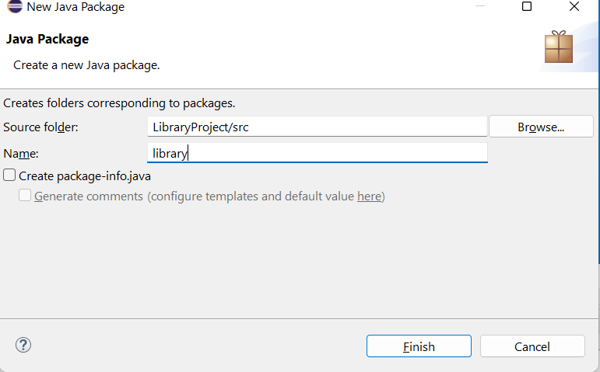
Part 2: OOP Case Study Implementation (30%)
3. Similar Example:
Superclass for a Library Book:
Step 3: Create a New Package
In the Project Explorer pane, right-click on the src folder under your project.
Select New -> Package.
Enter a package name, e.g., library.
Click Finish.
10

Slide 11
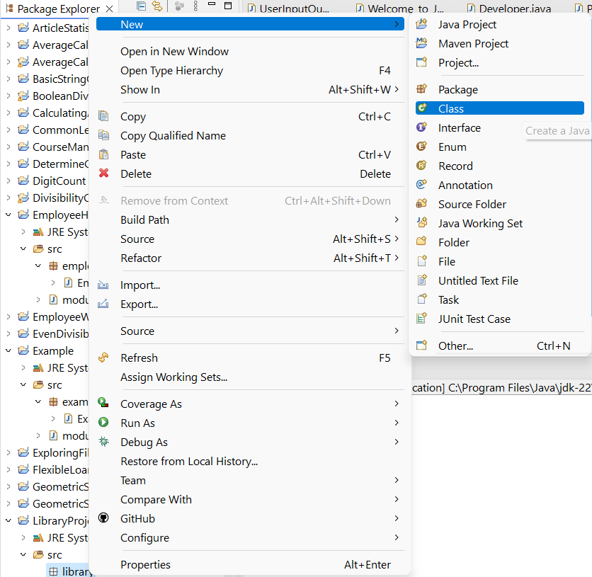
Part 2: OOP Case Study Implementation (30%)
3. Similar Example:
Superclass for a Library Book:
Step 4: Create a New Java Class for LibraryBook
Right-click on the newly created library package.
Select New -> Class.
Enter the class name as LibraryBook.
Click Finish.
11

Slide 12
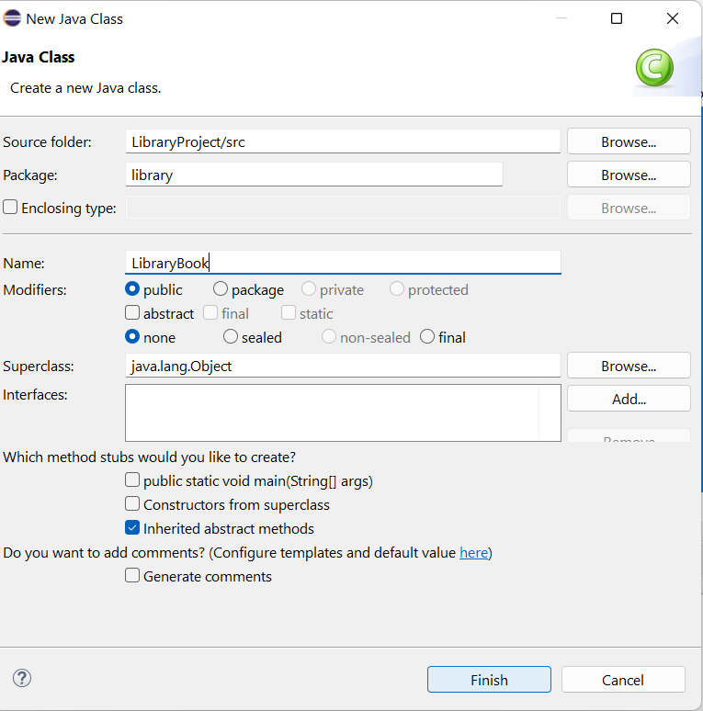
Part 2: OOP Case Study Implementation (30%)
3. Similar Example:
Superclass for a Library Book:
Step 5: Write the Code for LibraryBook
In the new LibraryBook.java file that opens, add the code for the LibraryBook class:
12

Slide 13
package library;
public class LibraryBook {
private String bookID;
private String title;
private String author;
private double price;
public LibraryBook(String bookID, String title, String author, double price) {
this.bookID = bookID;
this.title = title;
this.author = author;
this.price = price;
}
@Override
public String toString() {
return "Book ID: " + bookID + "\nTitle: " + title + "\nAuthor: " + author + "\nPrice: $" + price;
}
}
Step 6: Save the File:
Save the file by pressing Ctrl + S (Windows/Linux) or Cmd + S (Mac).
This code defines a LibraryBook class that stores information about a library book, including its ID, title, author, and price, and provides a method to return this information as a formatted string.
13

Slide 14
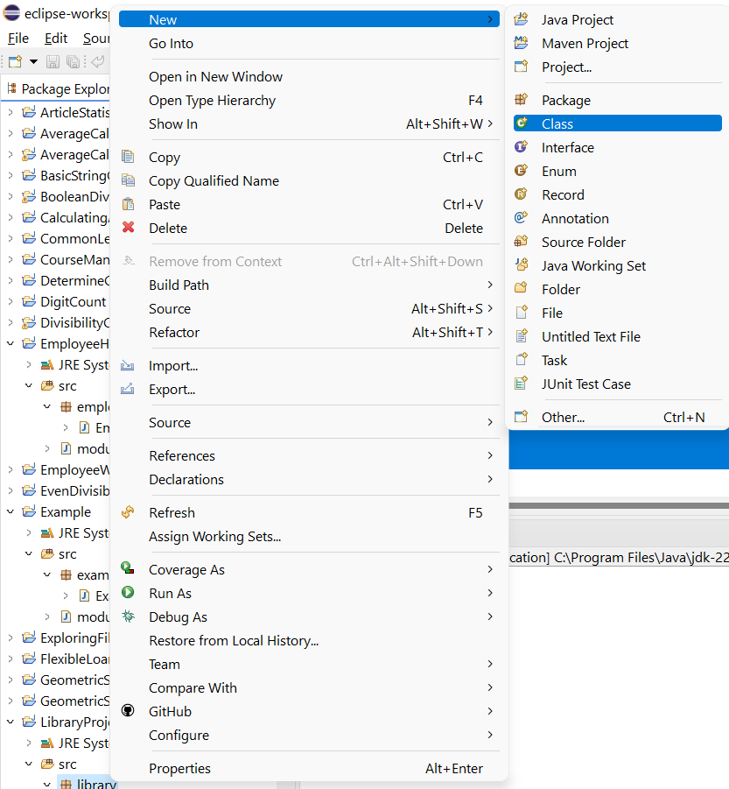
Step 7: Run the Program (Optional)
Although this class itself does not have a main method, we can create another class to test it. For example, we can create a new class, LibraryTest, in the same package to test the LibraryBook class.
Right-click on the library package.
Select New -> Class.
Name it LibraryTest and check the box to include a main method.
Click Finish.
14

Slide 15
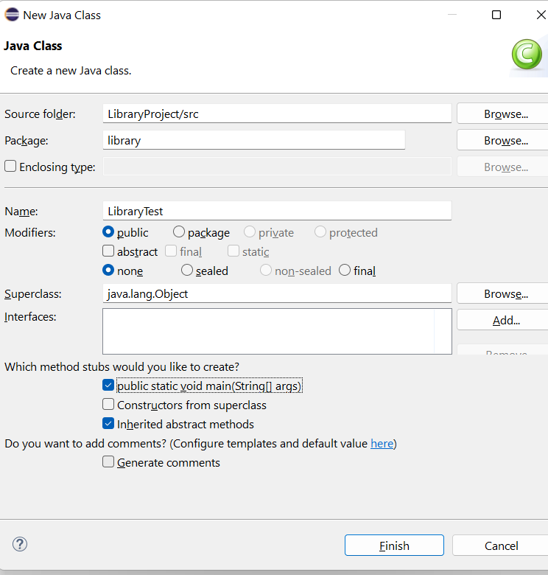
Step 7: Run the Program (Optional)
Although this class itself does not have a main method, we can create another class to test it. For example, we can create a new class, LibraryTest, in the same package to test the LibraryBook class.
Right-click on the library package.
Select New -> Class.
Name it LibraryTest and check the box to include a main method.
Click Finish.
15

Slide 16
Step 7: Run the Program (Optional)
In the LibraryTest.java, we can add code to test the LibraryBook class:
package library;
public class LibraryTest {
public static void main(String[] args) {
LibraryBook book = new LibraryBook("12345", "The Great Gatsby", "F. Scott Fitzgerald", 19.99);
System.out.println(book.toString());
}
}
16

Slide 17
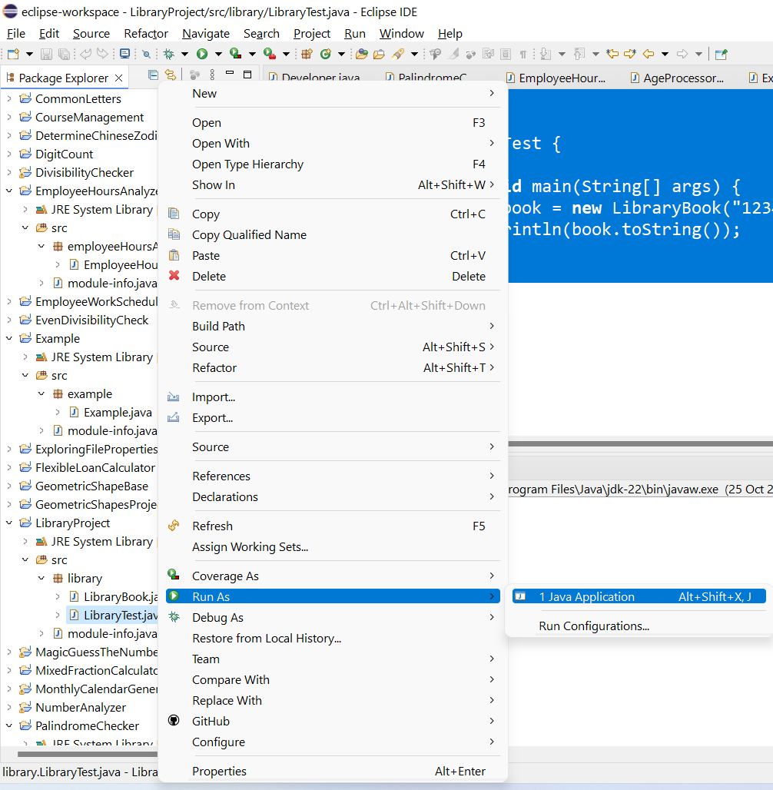
Step 8: Run the LibraryTest Class
Right-click on the LibraryTest.java file and select Run As -> Java Application.
The output should show the details of the LibraryBook object
The result displays the details of the LibraryBook object, showing the book ID, title, author, and price formatted as specified in the toString method.
17

Slide 18
Task 2: Fresh Fruit Subclass Creation (2%)
Instructions:
Create a subclass FreshFruit extending Product.
Include additional attributes (e.g., weight).
Override the toString() method to include the weight in the output.
18

Slide 19
2. What students need to do:
Define the FreshFruit class.
Implement additional attributes, constructors, and accessors.
Override toString() to show details of the fruit item.
19

Slide 20
3. Similar Example:
Subclass for eBook:
Step 1: Open Eclipse
Launch Eclipse IDE on your computer.
Step 2: Open the Existing Project or Create a New Project
If you already have the LibraryProject project open, continue with that.
If not, create a new Java project as described in previous steps.
20

Slide 21
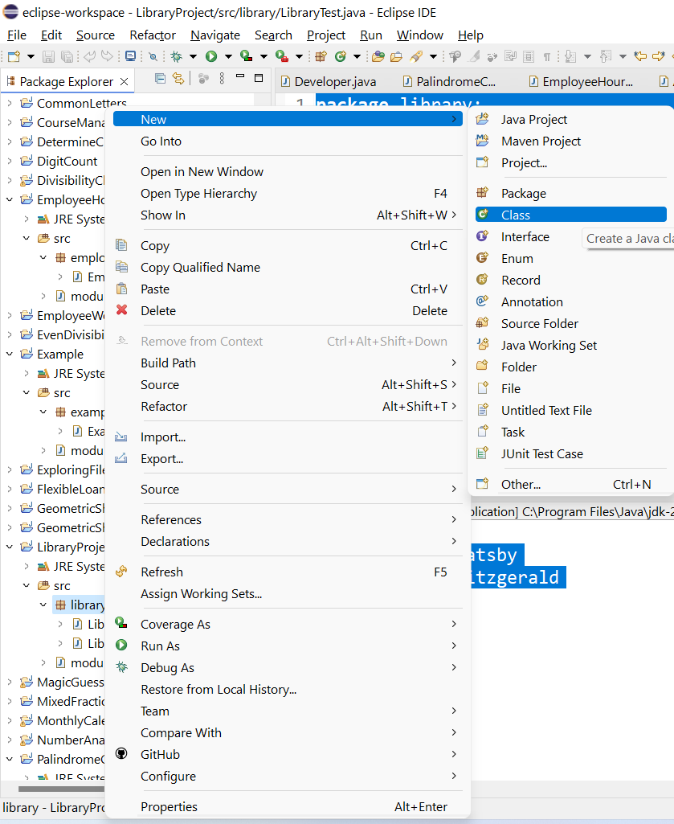
Step 3: Create the eBook Subclass
Open the library package in the Project Explorer where the LibraryBook class exists.
Right-click on the library package.
Select New -> Class.
Enter the class name as eBook.
Ensure that the eBook class will be created inside the same package as LibraryBook (i.e., library).
Click Finish.
21

Slide 22
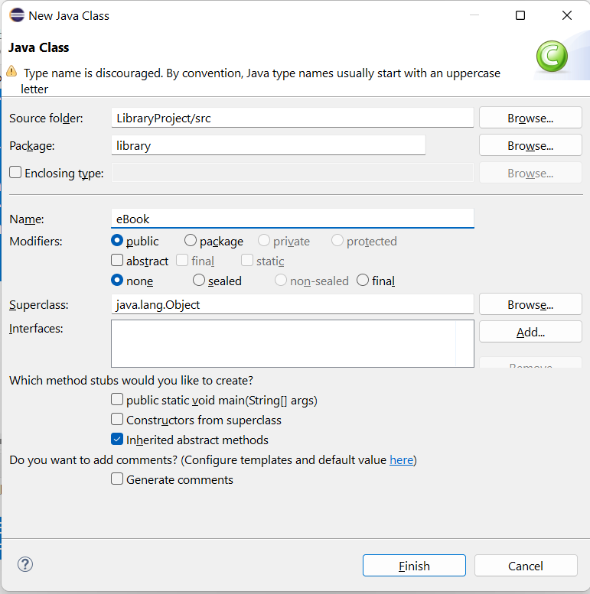
Step 3: Create the eBook Subclass
Open the library package in the Project Explorer where the LibraryBook class exists.
Right-click on the library package.
Select New -> Class.
Enter the class name as eBook.
Ensure that the eBook class will be created inside the same package as LibraryBook (i.e., library).
Click Finish.
22

Slide 23
Step 4: Write the Code for eBook
In the new eBook.java file that opens, add the code for the eBook class:
package library;
public class eBook extends LibraryBook {
private double fileSize; // in MB
public eBook(String bookID, String title, String author, double price, double fileSize) {
super(bookID, title, author, price);
this.fileSize = fileSize;
}
@Override
public String toString() {
return super.toString() + "\nFile Size: " + fileSize + " MB";
}
}
This eBook class extends the LibraryBook class, adding a fileSize attribute and overriding the toString() method to include the file size in the output.
23

Slide 24
Step 5: Save the File
Press Ctrl + S (Windows/Linux) or Cmd + S (Mac) to save the file.
Step 6: Update the LibraryTest Class to Include eBook
Open the LibraryTest.java file.
Modify it to test the eBook subclass by adding an instance of eBook:
24

Slide 25
package library;
public class LibraryTest {
public static void main(String[] args) {
// Create an instance of LibraryBook
LibraryBook book = new LibraryBook("12345", "The Great Gatsby", "F. Scott Fitzgerald", 19.99);
System.out.println(book.toString());
// Create an instance of eBook
eBook ebook = new eBook("54321", "1984", "George Orwell", 9.99, 2.5);
System.out.println(ebook.toString());
}
}
The code now includes the creation and testing of both a LibraryBook instance and an eBook instance. It prints the details of both, with the eBook instance showing the additional fileSize attribute.
25

Slide 26
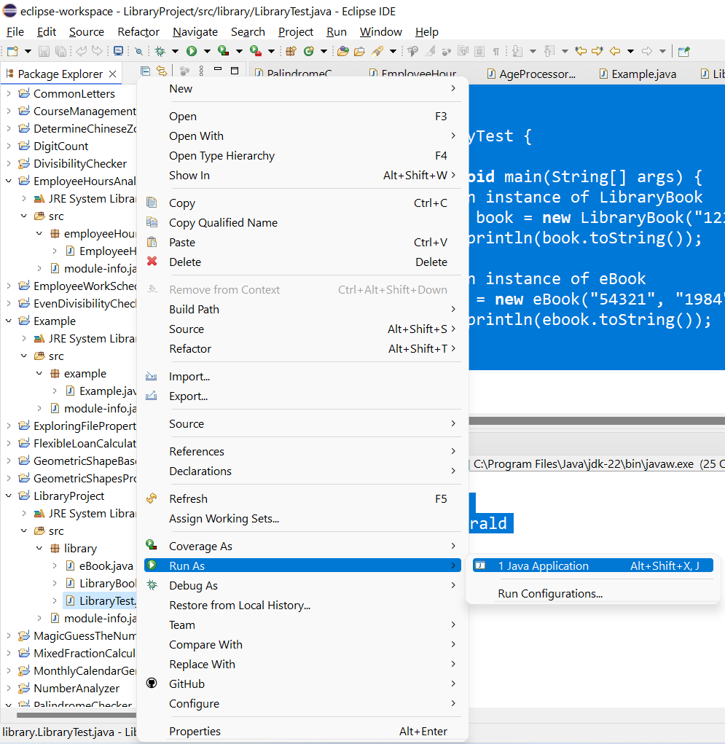
Step 7: Run the Program
Right-click on the LibraryTest.java file and select Run As -> Java Application.
The output should display the details for both the LibraryBook and the eBook objects:
26

Slide 27
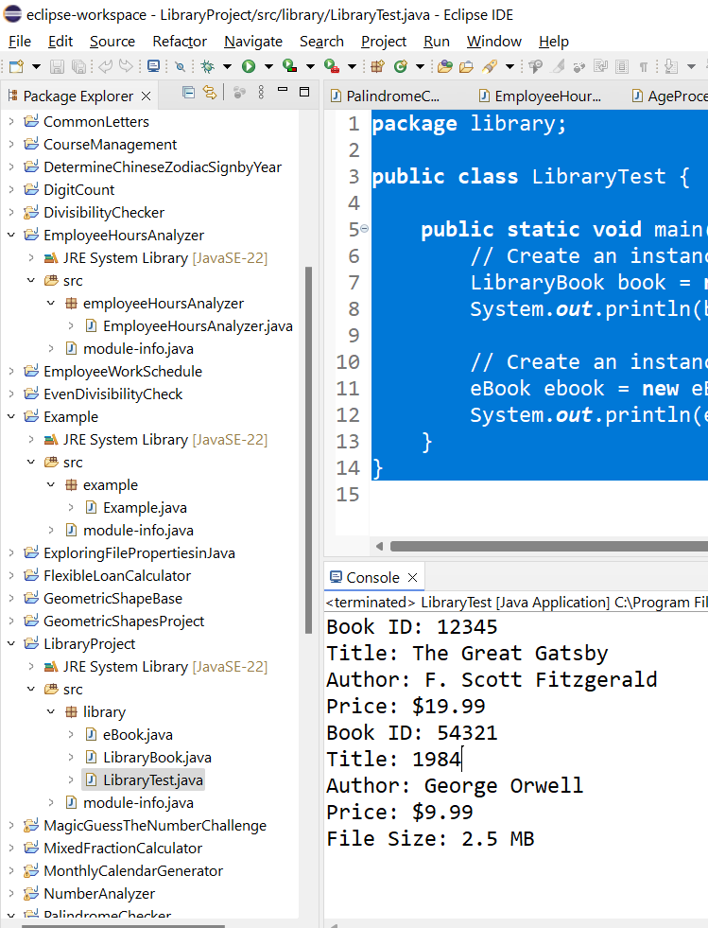
This demonstrates how to create and display both a LibraryBook and its subclass eBook, which adds additional attributes and functionality (e.g., file size).
27

Slide 28
Task 3: Packaged Item Subclass Creation (2%)
1. Instructions:
Create a subclass Packaged extending Product.
Include attributes for quantity and use-by date.
Override the toString() method to include quantity and use-by date in the output.
28

Slide 29
Task 3: Packaged Item Subclass Creation (2%)
2. What you need to do:
Define the Packaged class.
Implement additional attributes and methods.
Override toString() to display all relevant packaged item details.
29

Slide 30
Task 3: Packaged Item Subclass Creation (2%)
3. Similar Example:
Subclass for Hardcover Book
Step 1: Open Eclipse
Launch the Eclipse IDE.
Step 2: Open the Existing Project
Open the existing project (LibraryProject) where you already have the LibraryBook class.
30

Slide 31
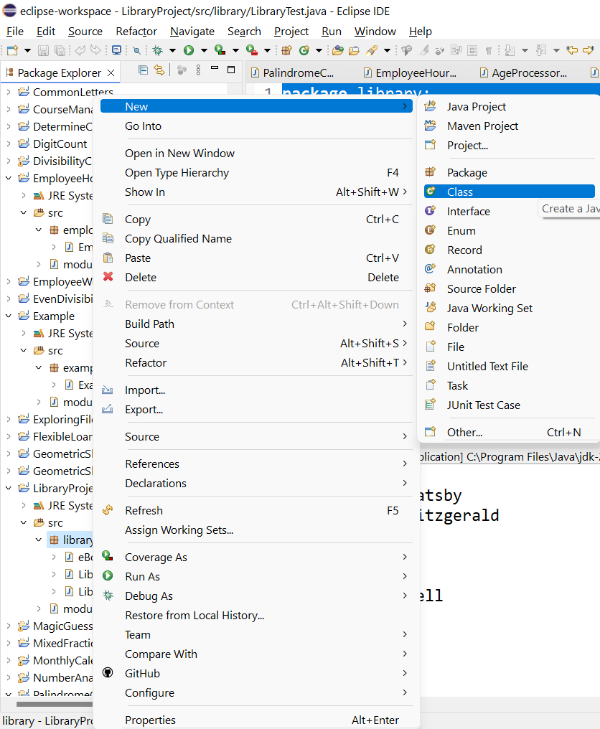
Task 3: Packaged Item Subclass Creation (2%)
Step 3: Create the HardcoverBook Subclass
In the Project Explorer pane, expand your project folder and right-click on the library package.
Select New -> Class.
Enter the class name as HardcoverBook.
Ensure the class is created in the library package.
Click Finish.
31

Slide 32
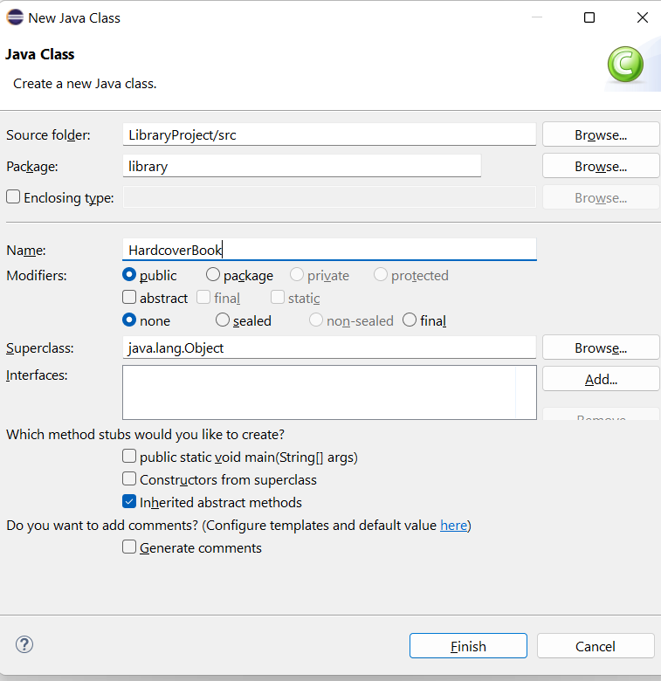
Task 3: Packaged Item Subclass Creation (2%)
Step 4: Write the Code for HardcoverBook
In the newly created HardcoverBook.java file, add the following code:
32

Slide 33
package library;
public class HardcoverBook extends LibraryBook {
private int pageCount;
public HardcoverBook(String bookID, String title, String author, double price, int pageCount) {
super(bookID, title, author, price);
this.pageCount = pageCount;
}
@Override
public String toString() {
return super.toString() + "\nPage Count: " + pageCount;
}
}
This HardcoverBook class extends LibraryBook by adding a pageCount attribute and overrides the toString() method to include the page count in the output.
33

Slide 34
Step 5: Save the File
Press Ctrl + S (Windows/Linux) or Cmd + S (Mac) to save the file.
Step 6: Update the LibraryTest Class to Include HardcoverBook
Open the LibraryTest.java file.
Modify the LibraryTest class to create and test an instance of HardcoverBook:
34

Slide 35
package library;
public class LibraryTest {
public static void main(String[] args) {
// Create an instance of LibraryBook
LibraryBook book = new LibraryBook("12345", "The Great Gatsby", "F. Scott Fitzgerald", 19.99);
System.out.println(book.toString());
// Create an instance of eBook
eBook ebook = new eBook("54321", "1984", "George Orwell", 9.99, 2.5);
System.out.println(ebook.toString());
// Create an instance of HardcoverBook
HardcoverBook hardcover = new HardcoverBook("67890", "To Kill a Mockingbird", "Harper Lee", 24.99, 324);
System.out.println(hardcover.toString());
}
}
35

Slide 36
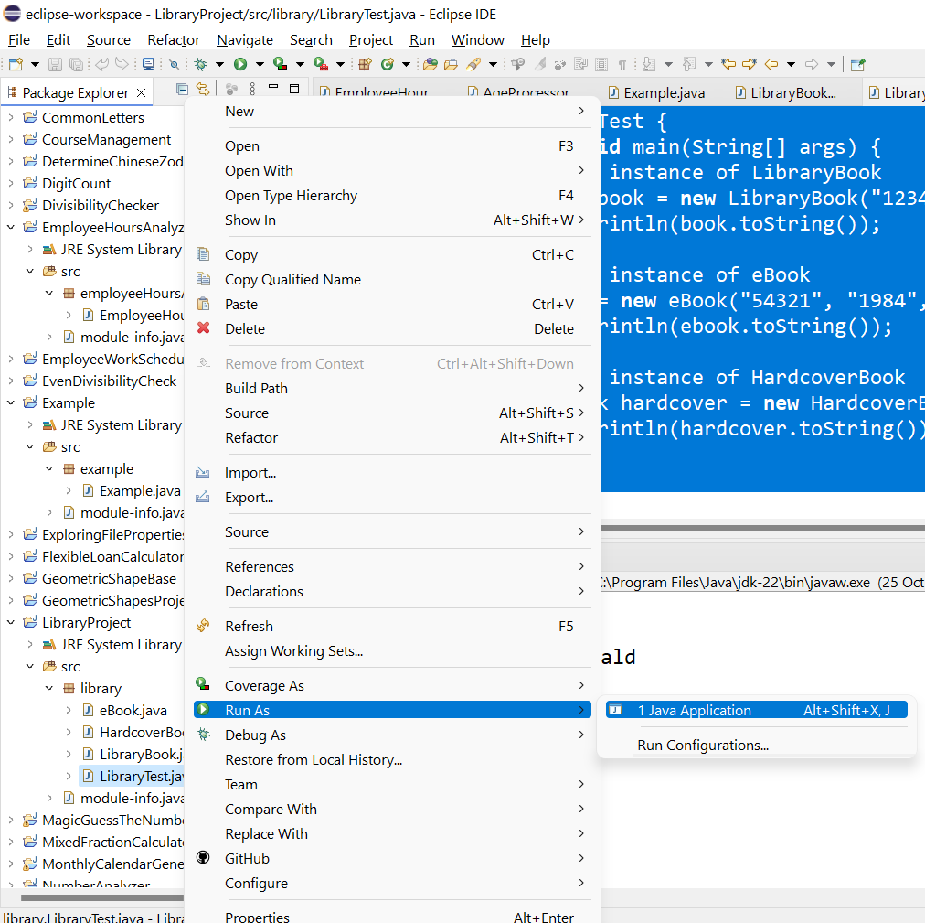
Step 7: Run the Program
Right-click on the LibraryTest.java file and select Run As -> Java Application.
The output should now display the details of the LibraryBook, eBook, and HardcoverBook objects:
36

Slide 37
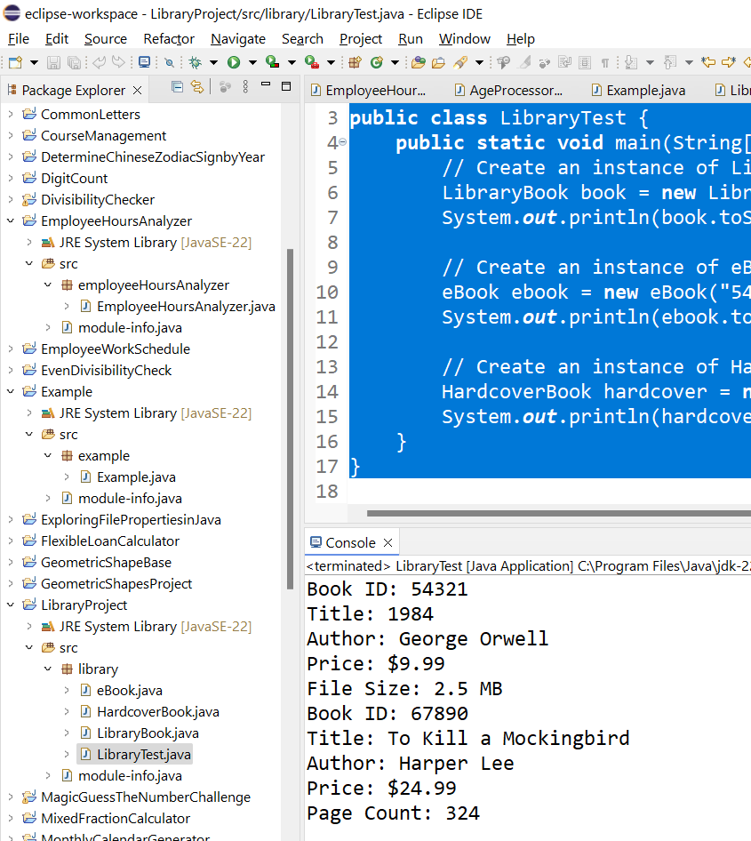
We now have successfully created and tested the HardcoverBook subclass, which extends LibraryBook and adds a pageCount attribute. The toString() method in HardcoverBook appends the page count to the book details, and the output reflects this information when the program runs.
37

Slide 38
Task 4: UML Diagram Creation (5%)
1. Instructions:
Draw a UML class diagram representing the relationships between the Product, FreshFruit, and Packaged classes.
2. What you need to do:
Use a tool like Lucidchart or draw.io to create the UML diagram.
Show attributes, methods, and relationships between classes (inheritance).
Include the diagram in the report, along with a brief explanation.
38

Slide 39
Similar Example:
UML Diagram:
Class: LibraryBook
Subclass: eBook
Subclass: HardcoverBook
Relationships: Inheritance (Parent to Child)
39

Slide 40
Task 5: Driver Class with User Interaction (13%)
1. Instructions:
Create a driver class that adds items to the product list and interacts with the user through console or GUI to simulate purchases.
Implement file I/O to store product data.
40

Slide 41
2. What you need to do:
Write code to display product information and capture user input.
Create a docket system to calculate total costs and tax.
Use file I/O for loading product information.
41

Slide 42
3. Similar Example:
Driver for Library System
Step 1: Open Eclipse
Launch Eclipse IDE on your computer.
Step 2: Open or Create Your Java Project
Open the project you’ve already created (LibraryProject), where you have the LibraryBook, eBook, and HardcoverBook classes.
If you haven't already created this project, follow the earlier steps to create a new Java project.
42

Slide 43
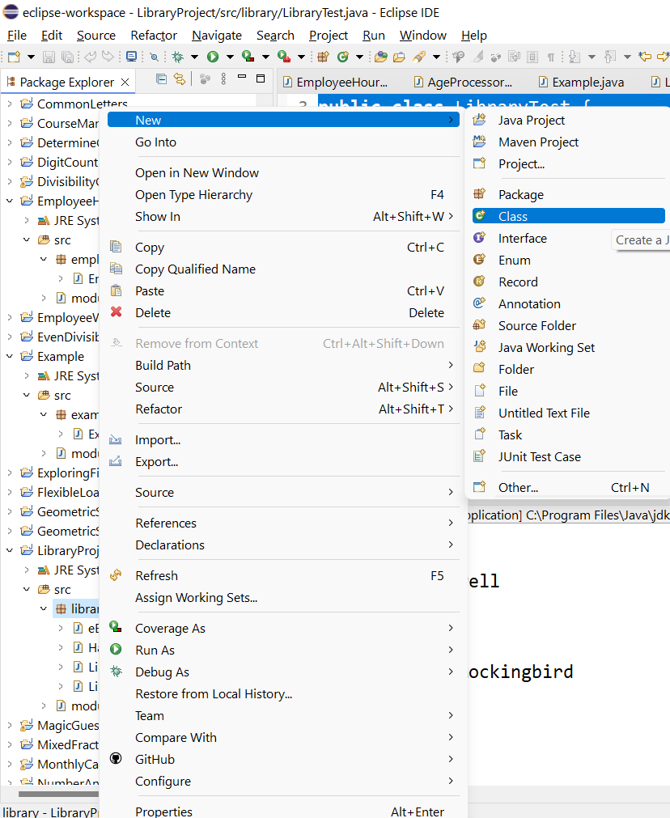
3. Similar Example:
Driver for Library System
Step 3: Create the LibraryDriver Class
In the Project Explorer, right-click on the library package.
Select New -> Class.
Name the class LibraryDriver.
Check the option to add the main method.
Click Finish.
43

Slide 44
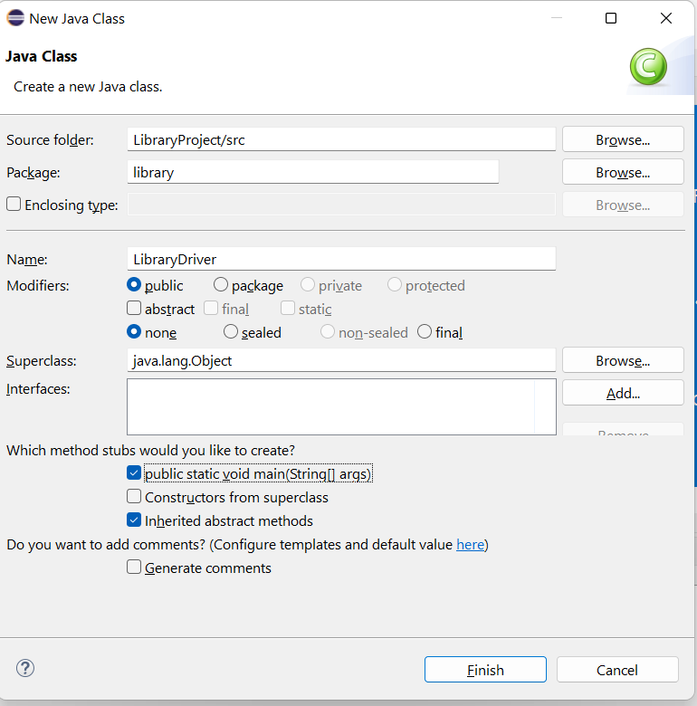
3. Similar Example:
Driver for Library System
Step 3: Create the LibraryDriver Class
In the Project Explorer, right-click on the library package.
Select New -> Class.
Name the class LibraryDriver.
Check the option to add the main method.
Click Finish.
44

Slide 45
This LibraryDriver class creates an array of LibraryBook objects, including both eBook and HardcoverBook, and prints their details by iterating through the array.
package library;
public class LibraryDriver {
public static void main(String[] args) {
// Create an array of LibraryBook objects, including eBook and HardcoverBook
LibraryBook[] books = {
new eBook("E001", "Learn Java", "John Doe", 19.99, 5.0),
new HardcoverBook("H001", "Design Patterns", "Jane Smith", 49.99, 300)
};
// Loop through the array and print out the details of each book
for (LibraryBook book : books) {
System.out.println(book);
}
}
}
Step 4: Write the Code for LibraryDriver
In the newly created LibraryDriver.java file, add the above code
45

Slide 46
This LibraryDriver class creates an array of LibraryBook objects, including both eBook and HardcoverBook, and prints their details by iterating through the array.
package library;
public class LibraryDriver {
public static void main(String[] args) {
// Create an array of LibraryBook objects, including eBook and HardcoverBook
LibraryBook[] books = {
new eBook("E001", "Learn Java", "John Doe", 19.99, 5.0),
new HardcoverBook("H001", "Design Patterns", "Jane Smith", 49.99, 300)
};
// Loop through the array and print out the details of each book
for (LibraryBook book : books) {
System.out.println(book);
}
}
}
Step 5: Save the File
Press Ctrl + S (Windows/Linux) or Cmd + S (Mac) to save the file.
46

Slide 47
This LibraryDriver class creates an array of LibraryBook objects, including both eBook and HardcoverBook, and prints their details by iterating through the array.
package library;
public class LibraryDriver {
public static void main(String[] args) {
// Create an array of LibraryBook objects, including eBook and HardcoverBook
LibraryBook[] books = {
new eBook("E001", "Learn Java", "John Doe", 19.99, 5.0),
new HardcoverBook("H001", "Design Patterns", "Jane Smith", 49.99, 300)
};
// Loop through the array and print out the details of each book
for (LibraryBook book : books) {
System.out.println(book);
}
}
}
Step 6: Check Your Other Classes
Ensure that your LibraryBook, eBook, and HardcoverBook classes are correctly implemented and available in the library package. If they are not present, follow the previous steps to create them.
47

Slide 48
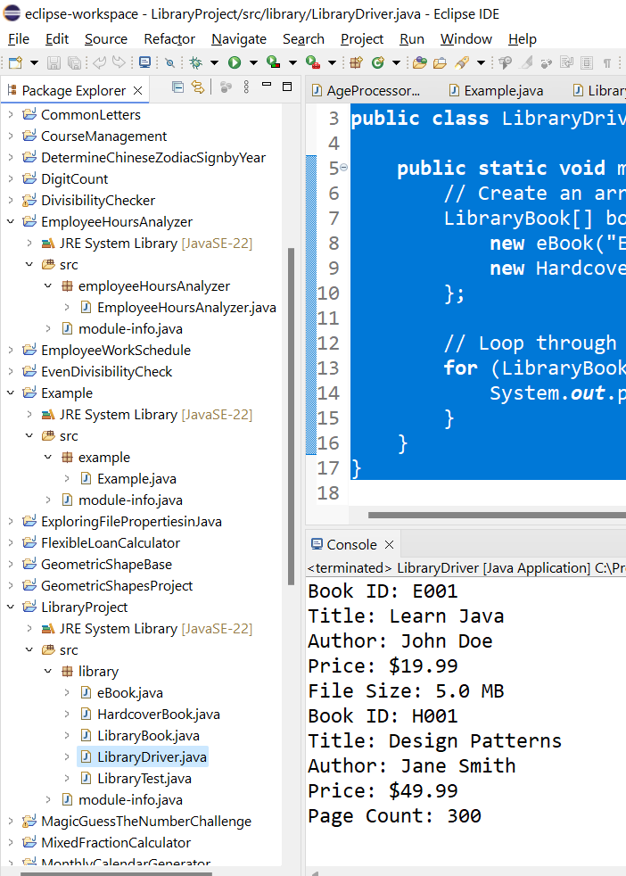
Step 8: Review the Output
After running the program, the console should display the details of both the eBook and HardcoverBook instances:
48

Slide 49
Explanation:
The program creates an array of LibraryBook objects, which includes one eBook and one HardcoverBook.
It loops through the array and prints the details of each book using the overridden toString() method in both subclasses.
The console output displays the book details, including specific attributes for each book type like File Size for eBook and Page Count for HardcoverBook.
49

Slide 50
Task 6: Recorded Video (5%)
1. Instructions:
Record a 5-15 minute video explaining the case study, showing the code and the program in action.
Discuss how OOP concepts were applied and explain key features.
50

Slide 51
2. What you need to do:
Prepare a demo showcasing the code, explaining the use of OOP concepts, and highlighting areas for improvement.
51

Slide 52
Thanks!
Happy a Learning Day!
ITEC618 - PROGRAMMING CONCEPTS
Lecturer: Dr. Farshid Keivanian

